Slide 1
GoodReads Books ETL Pipeline project

Slide 2
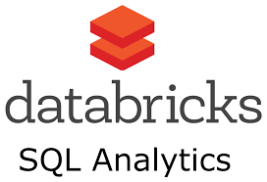
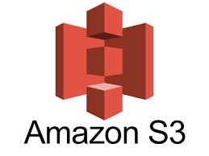
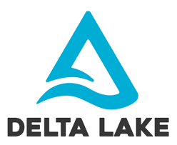

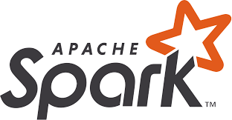

High Level Architecture Diagram
Book Review
dataset
Clean, Transform and normalize
Database views
Silver Zone

Slide 3
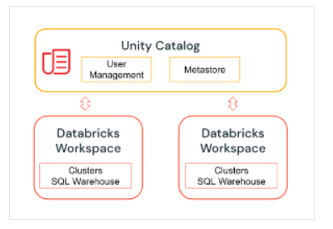
Unity Catalog Overview

Slide 4
Unity Catalog model
A metastore is the top-level container of objects in Unity Catalog. It stores data assets (tables and views) and the permissions that govern access to them. Azure Databricks account admins can create a metastore for each region in which they operate and assign them to Azure Databricks workspaces in the same region. For a workspace to use Unity Catalog, it must have a Unity Catalog metastore attached.
A catalog is the first layer of Unity Catalog’s three-level namespace. It’s used to organize your data assets. Users can see all catalogs on which they have been assigned the USE CATALOG data permission.
A schema (also called a database) is the second layer of Unity Catalog’s three-level namespace. A schema organizes tables and views. To access (or list) a table or view in a schema, users must have the USE SCEHMA data permission on the schema and its parent catalog, and they must have the SELECT permission on the table or view.
A table resides in the third layer of Unity Catalog’s three-level namespace. It contains rows of data. To create a table, users must have CREATE and USE SCHEMA permissions on the schema, and they must have the USE CATALOG permission on its parent catalog. To query a table, users must have the SELECT permission on the table, the USE SCHEMA permission on its parent schema, and the USE CATALOG permission on its parent catalog.

Slide 5
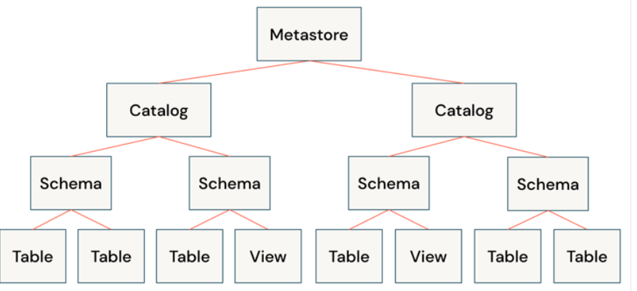
The Unity Catalog object model

Slide 6
Audit access
A complete data governance solution requires auditing access to data and providing alerting and monitoring capabilities. Unity Catalog captures an audit log of actions performed against the metastore and these logs are delivered as part of AWS Databricks audit logs.

Slide 7
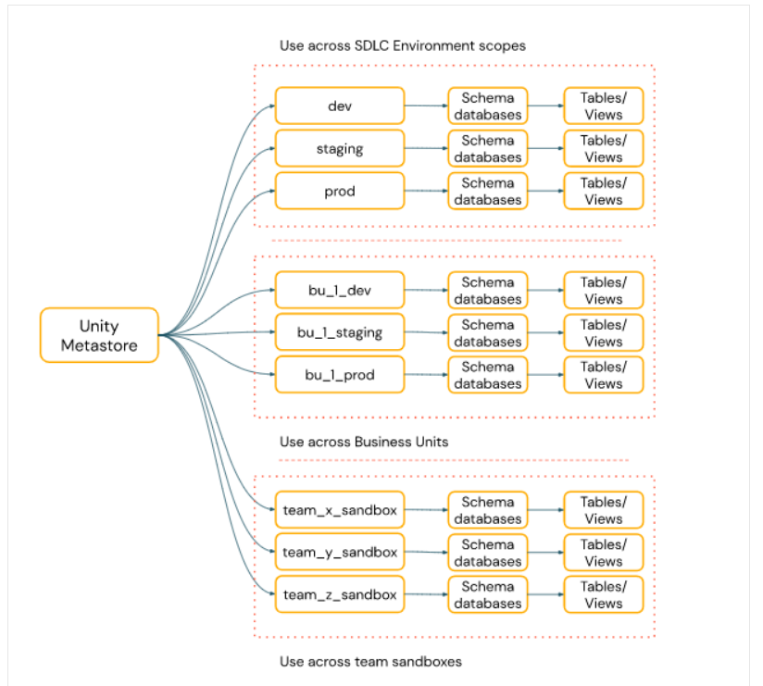
Organize your data

Slide 8
Problems without Unity Catalog
There is no way to control ACL across workspaces
Tracking Lineage is difficult
No way to group resources belonging to an environment under same head and control access

Slide 9
Delta Sharing
Delta Sharing is an open protocol developed by Databricks for secure data sharing with other organizations or other departments within your organization, regardless of which computing platforms they use. When Delta Sharing is enabled on a metastore, Unity Catalog runs a Delta Sharing server.
To share data between metastores, you can leverage Databricks-to-Databricks Delta Sharing. This allows you to register tables from metastores in different regions. These tables will appear as read-only objects in the consuming metastore. These tables can be granted access like any other object within Unity Catalog.

Slide 10
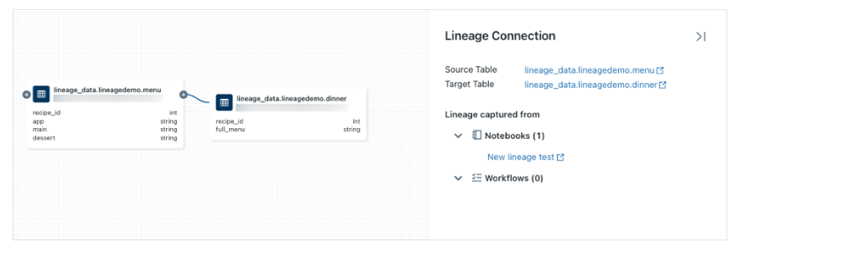
Lineage

Slide 11
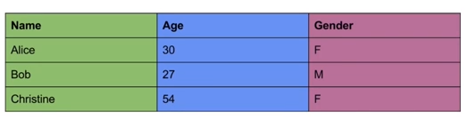

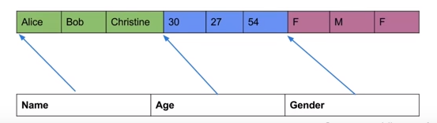
Parquet File format
A columnar storage instead of usual row based storage.
Normal Way of storing above data in disk:
How parquet file format is saved in disk:

Slide 12
ORC file format
A columnar file format used mostly in Hive
An improved version of RC file
Default stripe size is 256MB rather than 4MB for RC file.
If we read for a single column then we can get more data out of a 256MB stripe than a 4MB size and it fits HDFS need.
Has a footer which contains count,min,max and sum for each column.
With the help of the footer we can easily skip a block while we are reading out of it

Slide 13
Advantages of columnar file over row based storage
If we have to read only one column we can directly pick the column. There is no need to read the entire row.
If a dataset has 200 columns usually in any Spark SQL or other computations we would not use all the 200 columns, we would only use 2 or 3 columns for computations.
Since the datatypes are together, in the above case we all have String’s next to each other and then int next to each other and so on and that provides better compression.
It is not human readable

